Slide 1
Battle Of the Neighborhoods Austin, TX

Slide 2
Project analysis slide 2
Overview
RESULTS
INTRODUCTION
PROJECT
DISCUSSION
DATA
CONCLUSION
METHODOLOGY

Slide 3
Project analysis slide 4
Introduction
Introduction:
Austin, Texas topped the list of fastest growing cities in the United States for the past decade, topping out at a rate of 170 new residents per day in 2019. What makes Austin such an attractive option for residents looking to relocate?
This project will attempt to create a guide of the neighborhoods of Austin, specifically their cost of living and makeup of the businesses and amenities of each neighborhood. This in turn will help residents determine which neighborhood is right for them when looking for an area to relocate to.
People that are looking to relocate may find this guide useful in exploring the different areas of the city to check which one matches their interests and budget. City planners and people looking to start businesses may also find this analysis beneficial to them to figure out what areas they could potentially open businesses in based on the current portfolio of venues in the area
Management Objectives
Project Objectives
Implementation Plan

Slide 4
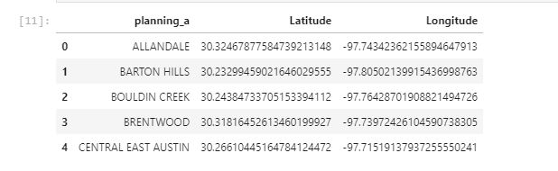
Project analysis slide 4
Data
Data:
Foursquare API – used to obtain data on the venues in the area and their geographical coordinates The data will be in the form of a json file that will be cleaned to a dataframe that contains the following information: Neighborhood, Latitude, Longitude , Venue, Name
Zillow API – used to obtain data on house and rental prices in each area. This data will then be grouped by neighborhood to provide some statistics on housing prices in the area. The data will be transformed into a pandas dataframe and joined with the foursquare data on popular venues in the neighborhood
Austin Neighborhood Data - .csv file of geofence of boundaries of the city of Austin neighborhoods. This was downloaded from the following url https://data.austintexas.gov/api/views/nz5f-3t2e/rows.json?accessType=DOWNLOAD
Management Objectives
Project Objectives
Implementation Plan

Slide 5
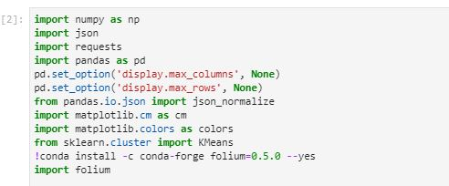
Project analysis slide 4
Libraries Used
Libraries used in this project
Management Objectives
Project Objectives
Implementation Plan

Slide 6
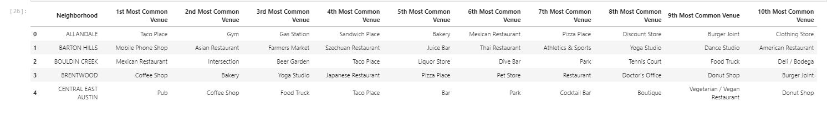
Project analysis slide 5
Foursquare Analysis
NUMBER OF NEIGHBORHOODS
MOST POPULAR VENUE
AVERAGE HOME PRICE
64
MEXICAN RESTAURANT
$ 583,000
There are 64 unique neighborhoods in Austin
Mexican Restaurants and taco places top the list of venues in Austin
The average home price ranged from a low of

Slide 7
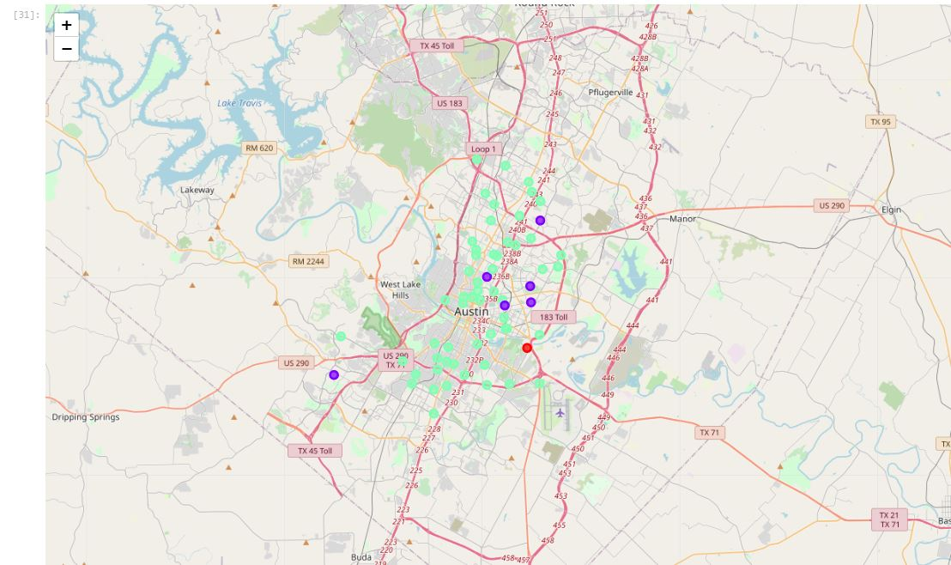
Project analysis slide 4
K Means Clustering
Neighborhood Clusters:
Cluster 0 (Red) –
Far from city center
1 neighborhood
Common Venues “Dive Bar” “Flea Market”
Cluster 1 (Purple)
Medium from city center
6 neighborhoods
Common Venues – “Park" “Playground” “Trails”
Cluster 2 (Green)
Close/medium/far from city center
20 neighborhoods
Common Venues – “Mexican Restaurant” “Hotel” “Bar” “Pub” “Taco Places”
Management Objectives
Project Objectives
Implementation Plan

Slide 8
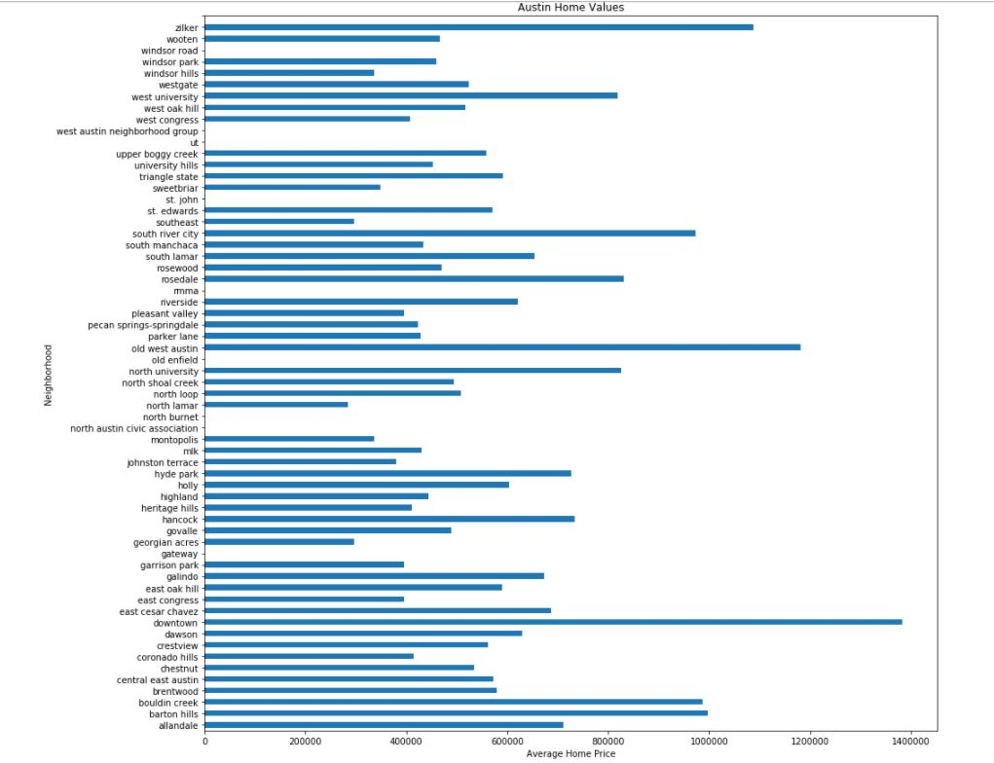
Project analysis slide 4
Home Values
Home Values:
Lowest Avg Home Value–
North Lamar - $284,612
Highest Average Home Value
Downtown – $1,383,616
50% percentile home value
.50 – $508,111
Management Objectives
Project Objectives
Implementation Plan

Slide 9
Project analysis slide 4
Conclusion
Conclusion:
This project aimed to help assist individuals looking to move to Austin with exploring areas of the city before planning an in person visit. This was done by collecting data from sources such as the Austin city government data website, Foursquare API, and Zillow to create profiles for neighborhoods based on their unique characteristics.
From there, the K means cluster algorithm was used to group together neighborhoods based on their characteristics into three different clusters. This provides a good baseline which would assist someone moving to the city in deciding which area was right for them and their particular situation.
Areas For Improvement
This project could be improved by taking out neighborhoods with less than 10 venues in foursquare, or by grouping smaller neighborhoods together into meta neighborhoods. Sometimes there was not enough venue data to properly classify the neighborhood compared to other neighborhoods that had significantly more venues. This project could also be improved by creating polygon shapes in folium to visualize neighborhood boundaries which would further help in segmenting which venues were a part of which neighborhood.
Management Objectives
Project Objectives
Implementation Plan

Slide 10
Thank You

